Slide 1

Analysis of Student Academic Performance
By
Anuoluwapo Aleem

Slide 2
Objectives
When we talk about student academic performance, having a good teacher or a motivated student is only a small portion of what ultimately contributes to a student’s success
There are a lot of factors involved which includes parental involvement, student assessment, lesson delivery etc.
The goal of this project is to identify the factors that influence students’ academic performance.

Slide 3
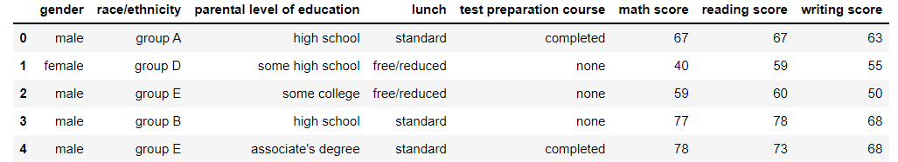
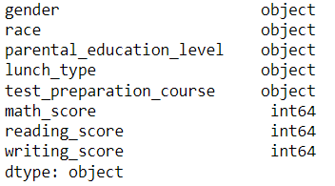
About Dataset
The dataset is available on https://www.kaggle.com/datasets/whenamancodes/students-performance-in-exams
It consists of the marks secured by 1000 students in 3 distinct subjects: Maths, Reading, and Writing.

Slide 4
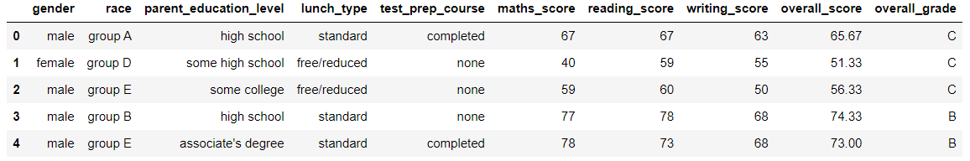
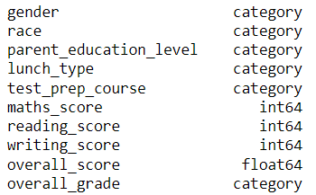
Data Cleaning
Renamed columns to more meaningful names
Assigned appropriate datatype
Created 2 new columns which include the average score and grade of each student.
Categorized average score into 5 groups:
O (Outstanding): 95-100
A (Very good): 81-94
B (Good): 71-80
C (Average): 51-70
F (Fail): 0-50
Checked for missing and duplicate values: 1 duplicate & 0 missing value

Slide 5
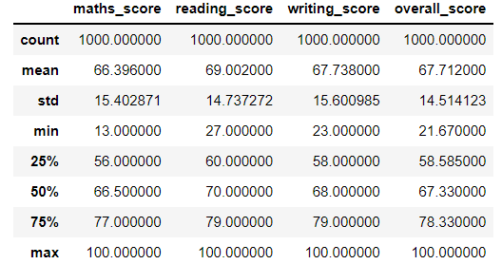
EDA Summary Statistics

Slide 6

Data Visualization

Slide 7
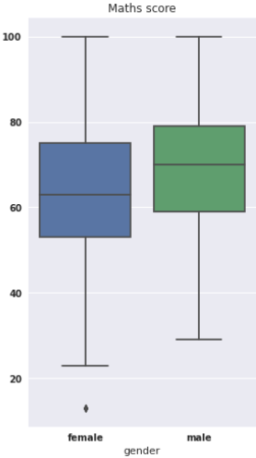
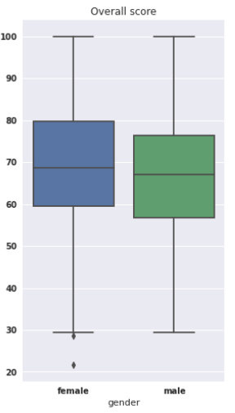
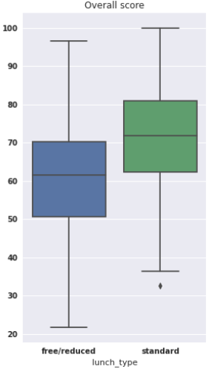
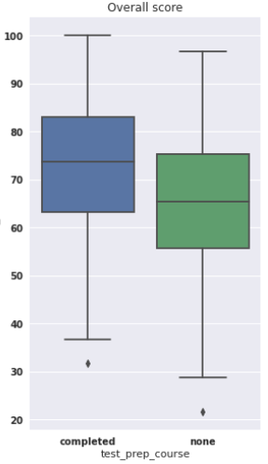
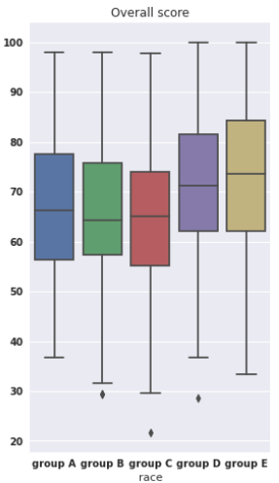
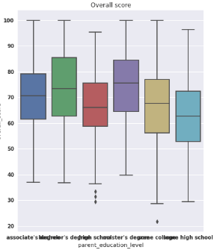
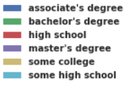
Data Visualization

Slide 8
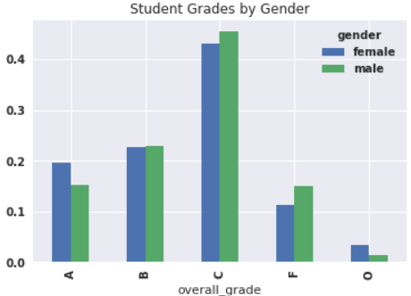
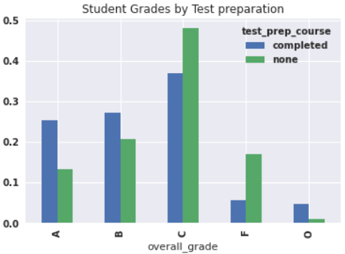
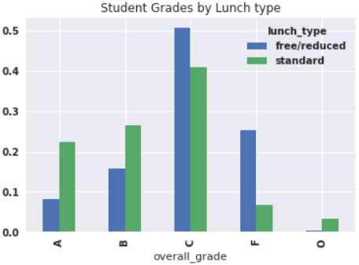
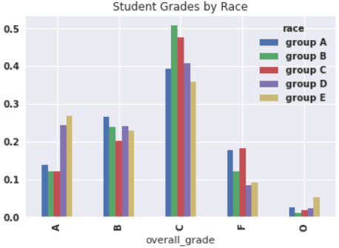
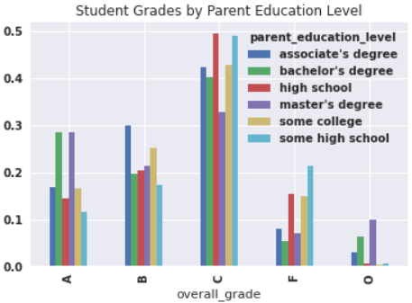
Data Visualization

Slide 9
Key Findings
This research has shown that;
Male students perform better in mathematics than female students, however female overall performance in mathematics, reading and writing is better than that of male.
Students from group E ethnicity had the best overall performance
Students who had standard lunch were seen to have the best performance. This shows that students are better learner when they're well nourished, and eating healthy meals has been linked to higher student performance. Healthy students are better learners.
As the education level of parents increases, the overall performance of student also increases.
Students who completed the preparation course had better performance than those who didn't complete it.

Slide 10
Conclusion
In conclusion, we have seen how gender, race, parent education level, eating healthy meal, and test preparation courses play major roles when it comes to academic performance of students.

